Slide 1
PROJECT
PLACEMENT MANAGEMENT SYSTEM

Slide 2
THEME OF THE PROJECT:
The primary theme is placement management, which involves organizing and streamlining the process of placing students into suitable job roles or internships. This theme is evident through the classes Student, Staff, and Placement, which collectively manage student data, eligibility criteria, and the placement process itself. Another aspect of the theme is student eligibility assessment. This defines criteria for determining whether a student is eligible for placement based on their academic performance (10th and 12th marks, CGPA). The code also reflects the theme of batch allocation, wherein selected students are divided into batches based on their placement marks and training performance. This allocation process is demonstrated in the Placement class through the func() method, where students are assigned to either Batch 1 or Batch 2 based on specific criteria. Through Java programming, the code automates various placement-related tasks, enhancing efficiency and reducing manual effort in managing the placement process.

Slide 3
CONCEPT USED IN THE PROJECT:
The code utilizes object-oriented programming concepts, defining classes such as Student, Staff, and Placement. These classes represent real-world entities and encapsulate their properties and behaviors. The Staff class extends the Student class, demonstrating the inheritance concept. It inherits the properties and methods of the Student class and adds additional attributes specific to staff members. The code uses ArrayLists to store collections of Staff objects, both for selected students and rejected students, as well as for organizing students into different batches. Methods are defined within classes to encapsulate specific functionalities, such as filtering students based on eligibility criteria and conducting placement tests. Control structures like loops and conditional statements are used to iterate over collections and make decisions based on certain conditions. The Scanner class is used to accept user input from the console, allowing users to input details for each student. The System.out.println() statements are used to display output to the console, providing information about the selected students, their batch allocations, and training statuses. Overall, the code demonstrates fundamental concepts of object-oriented programming, data structures, and user interaction in Java.

Slide 4
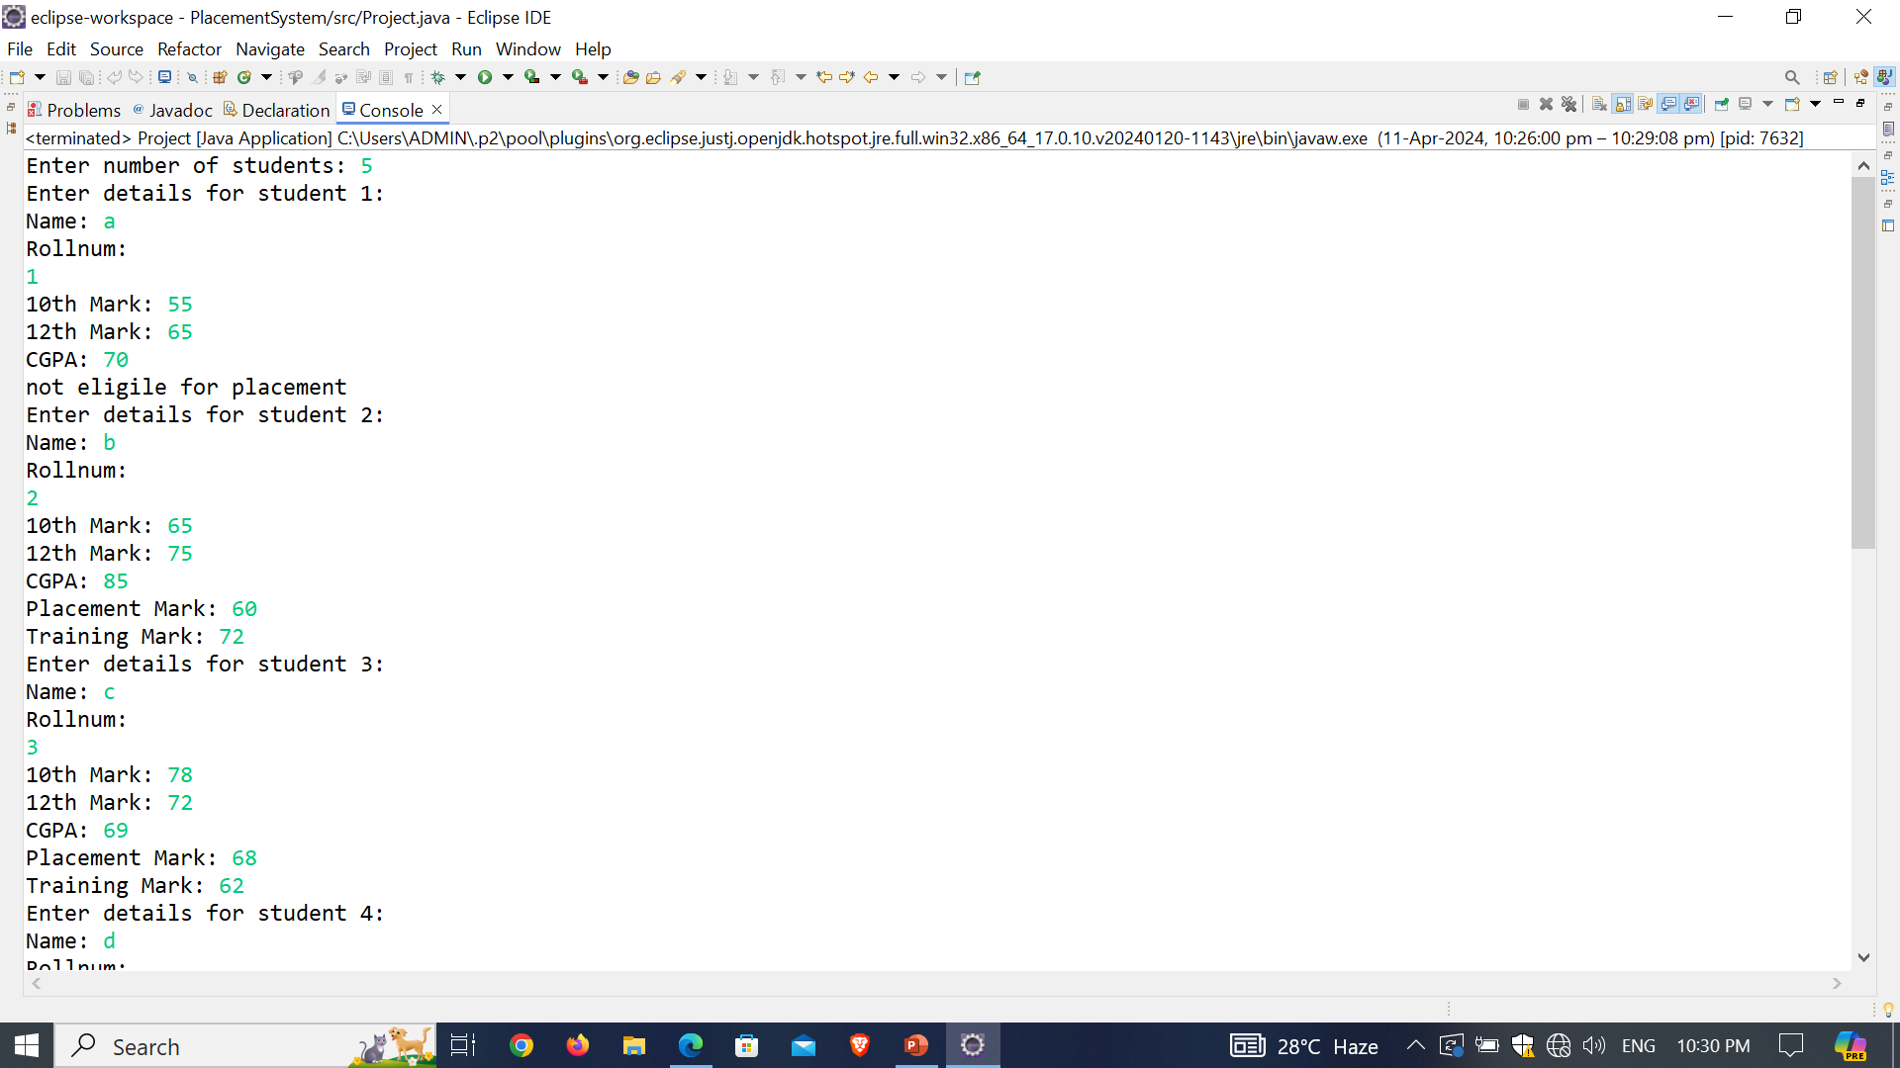
Output

Slide 5
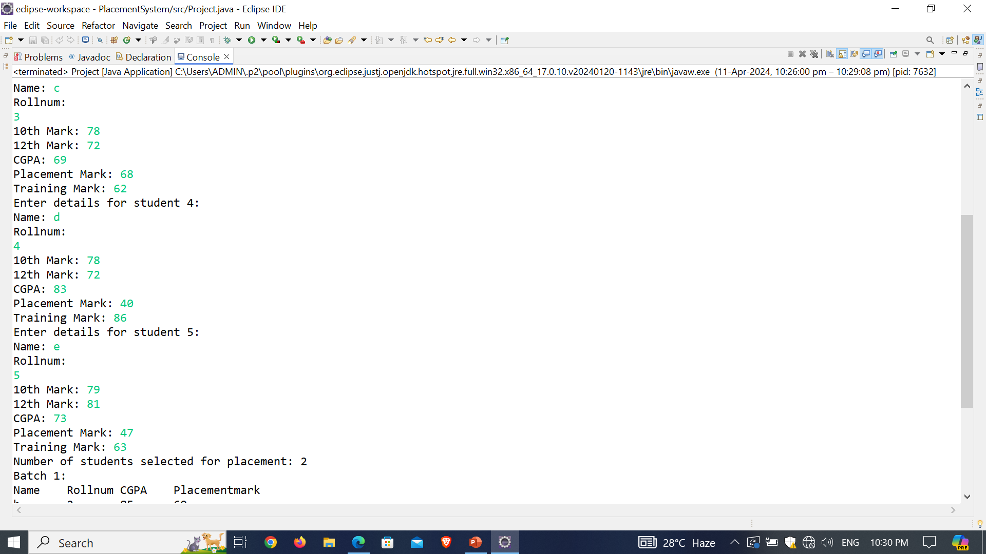

Slide 6
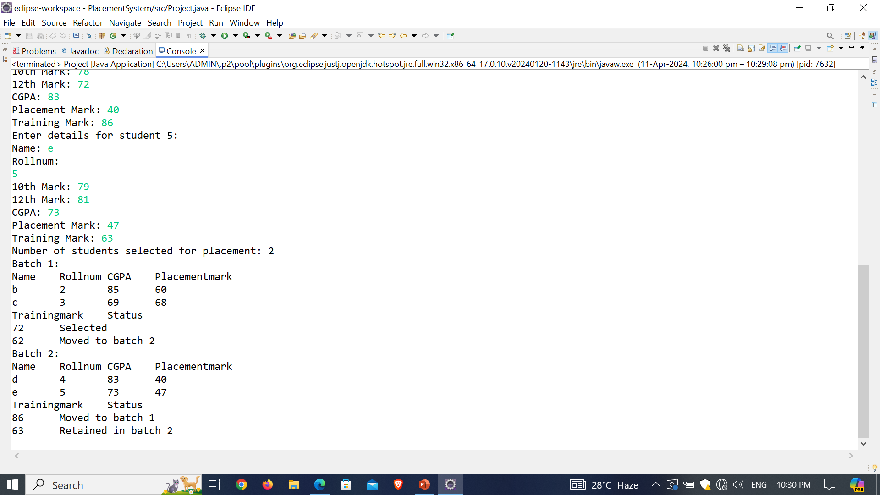

Slide 7
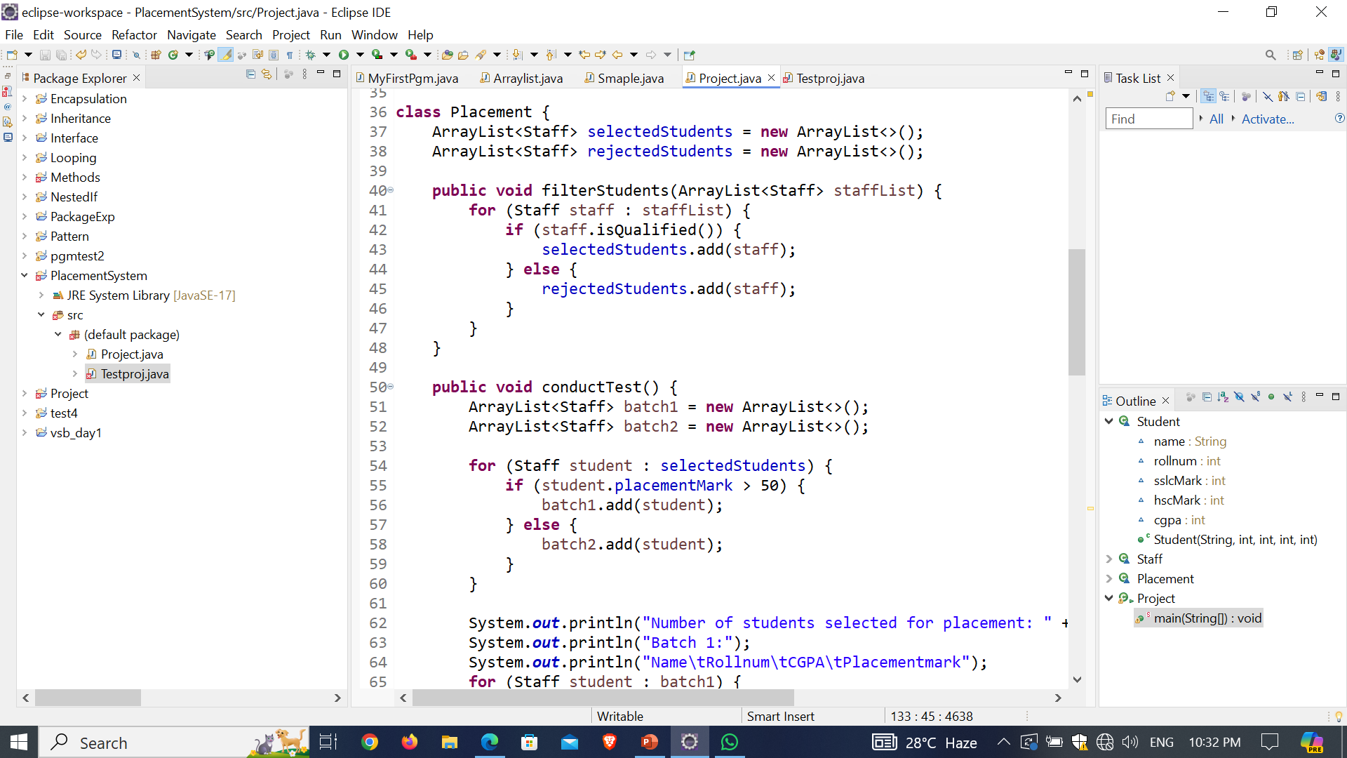
IMPORTANT CODING PART:

Slide 8
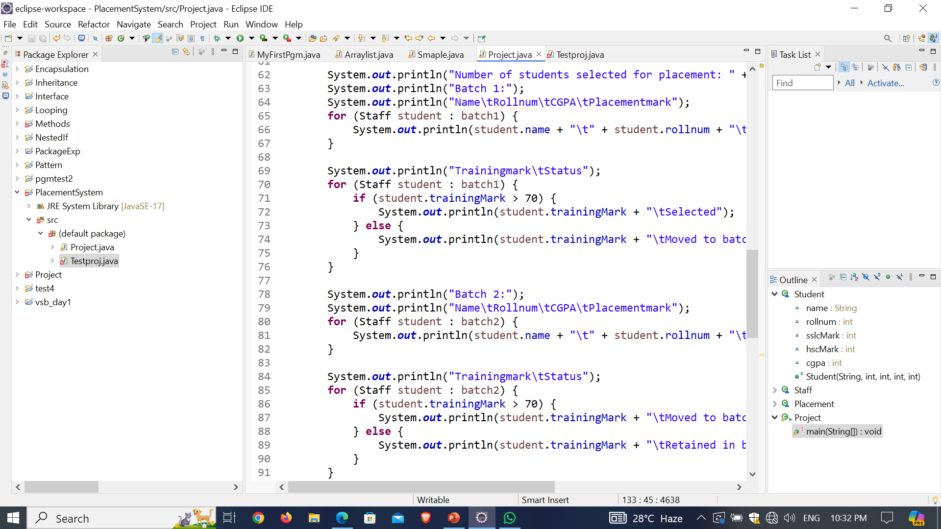

Slide 9
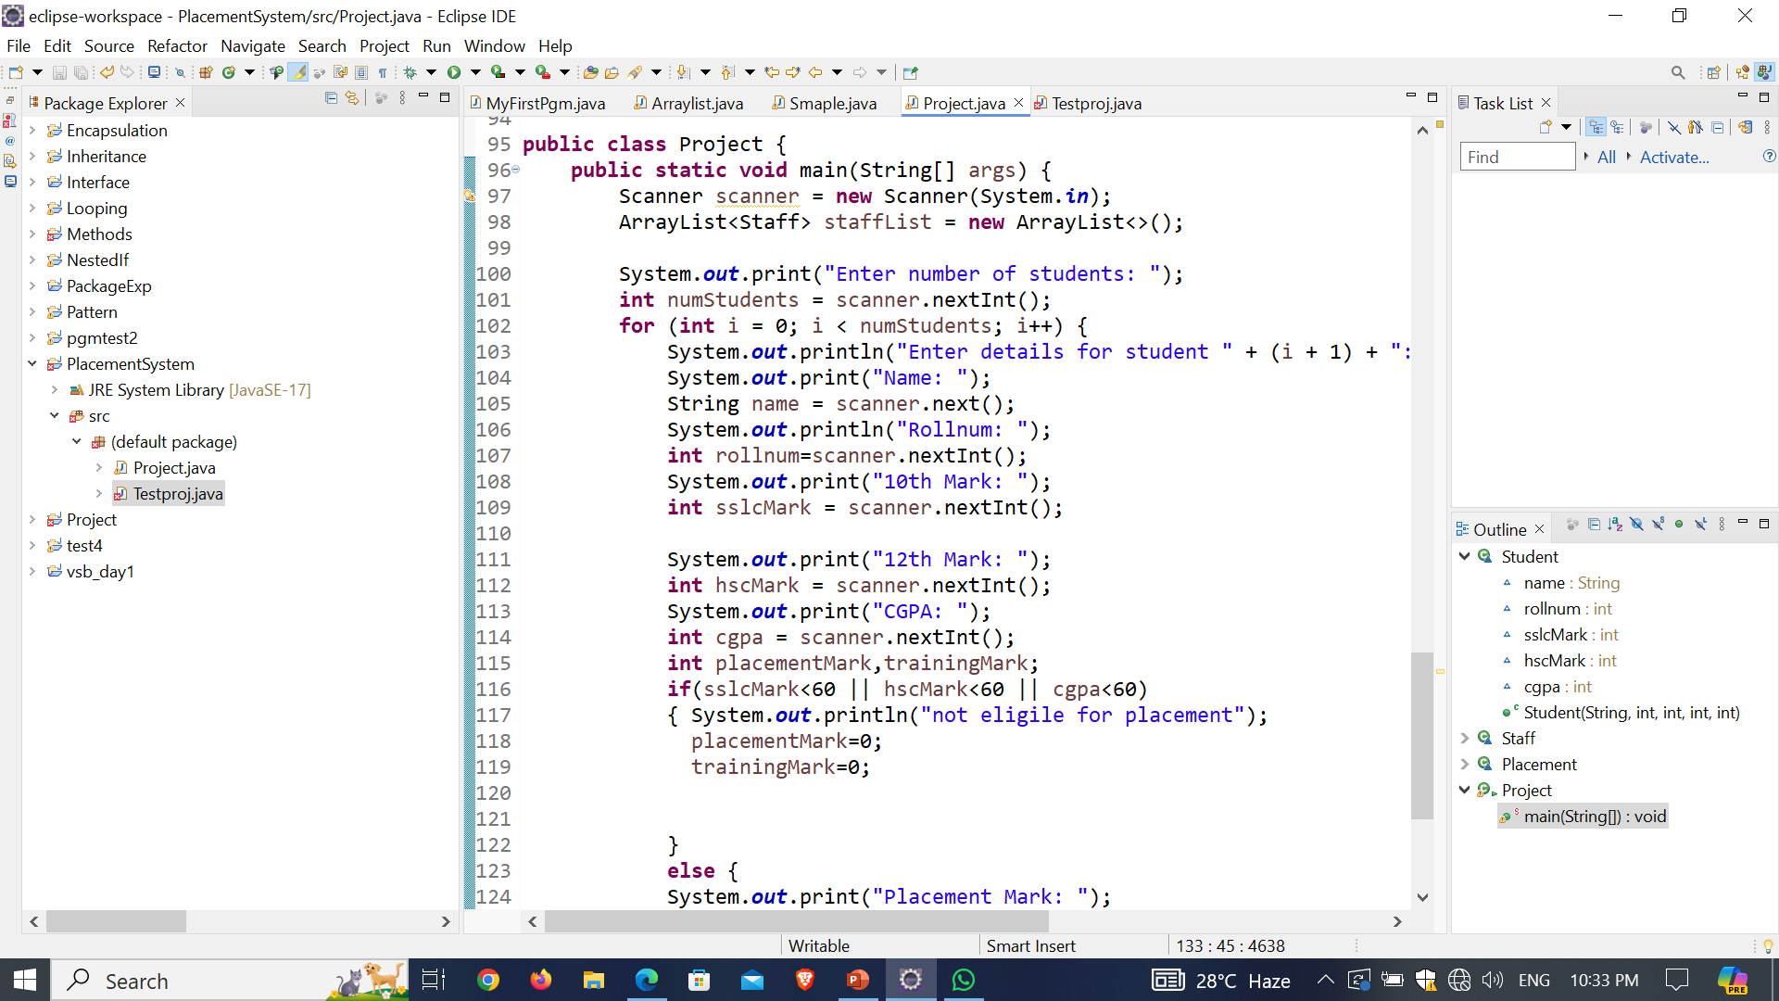

Slide 10
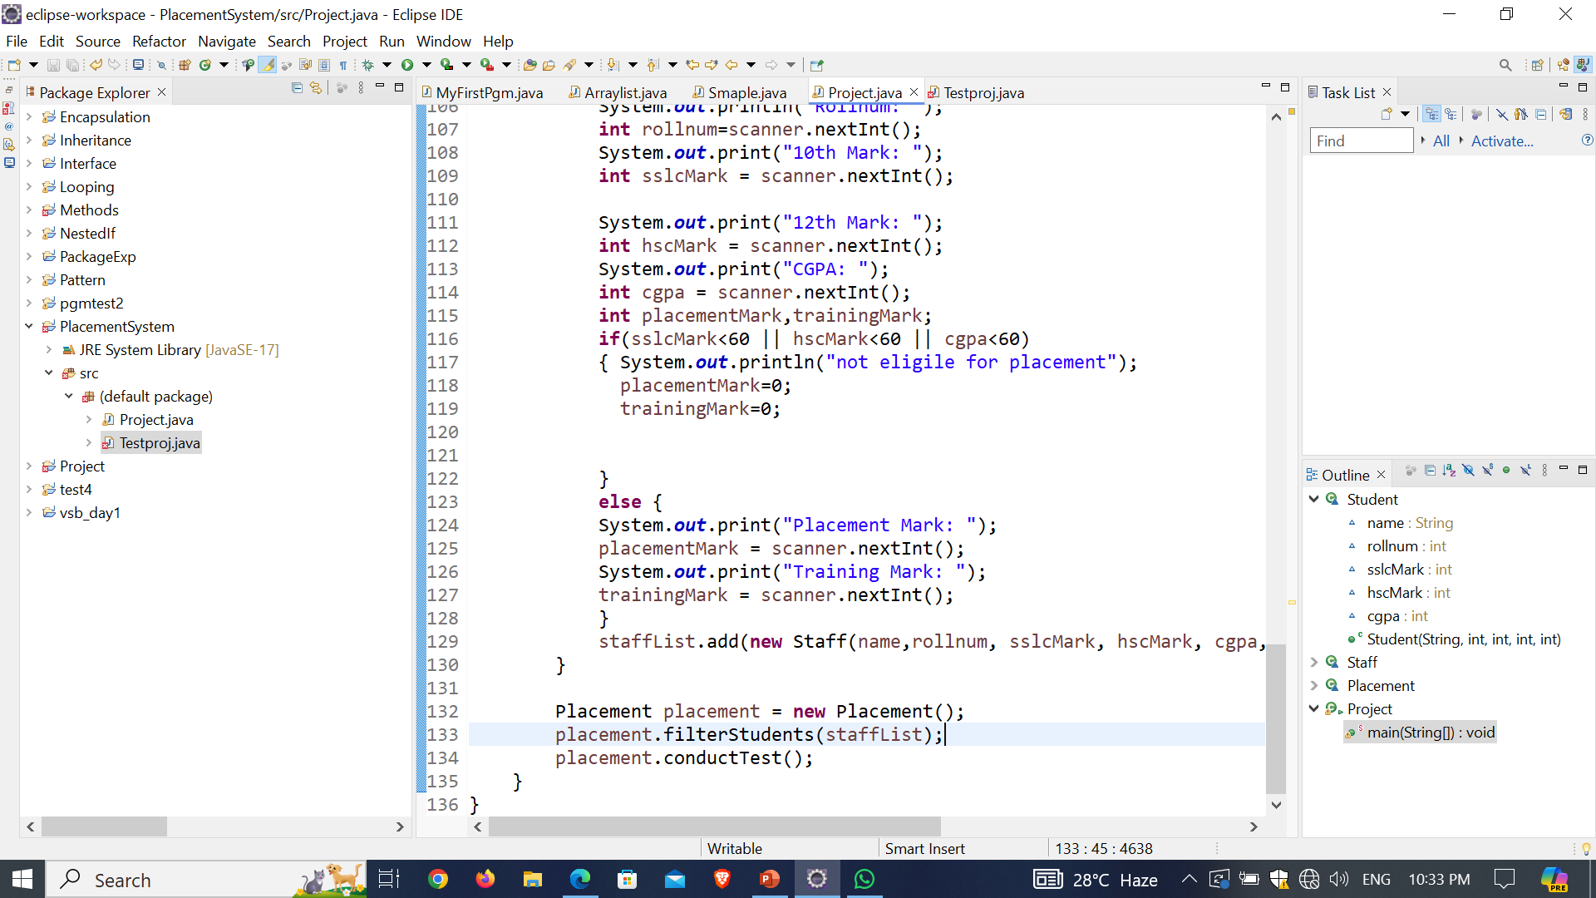

Slide 11
TEAM MEMBERS:
PRIJEESHA P
SNEHA PRIYAA J S
SRINITHI V
AISHWARIYA NADOM C
MOHANA PRIYA R
SOWMITHRA K
SUBHASHINI N

